Slide 1
Investigating the Effect of Textures on 3D Shape Perception in Visualization
Notes:
A key objective in visualization research is to design and implement algorithms to effectively communicate scientific data so that the essential features of the data can be understood intuitively and accurately.
The accurate perception of shape and surface details is crucial for correctly interpreting the images。
Previous research has shown that humans can perceive three-dimensional shape from two dimensional images using the pictorial cues present in the images.

Slide 2
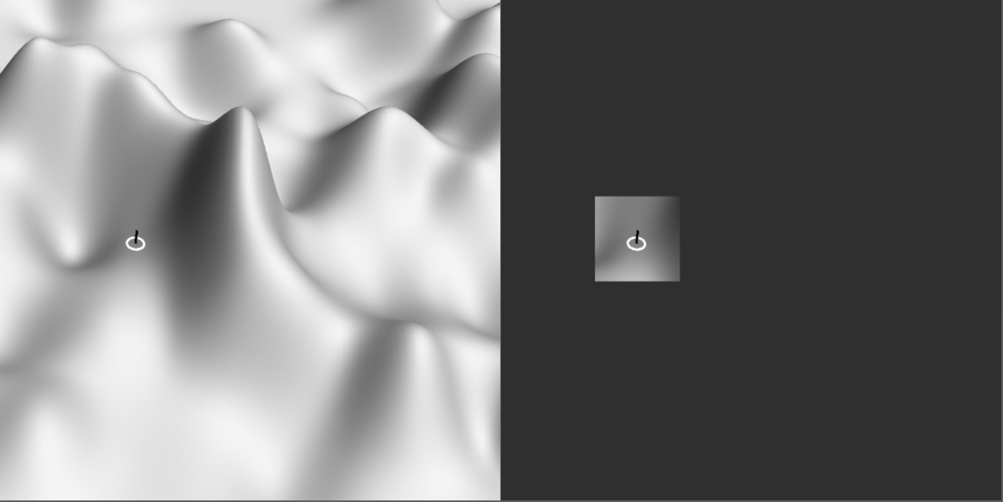
Image with Shading Only
Local
Global
Notes:
For example, shading is a pictorial cue that can be very effective in conveying three-dimensional shape. However, shading alone is not optimal for all purposes, since shading does not provide sufficient detail of local shape when the viewers zoom in on a part of the object.

Slide 3
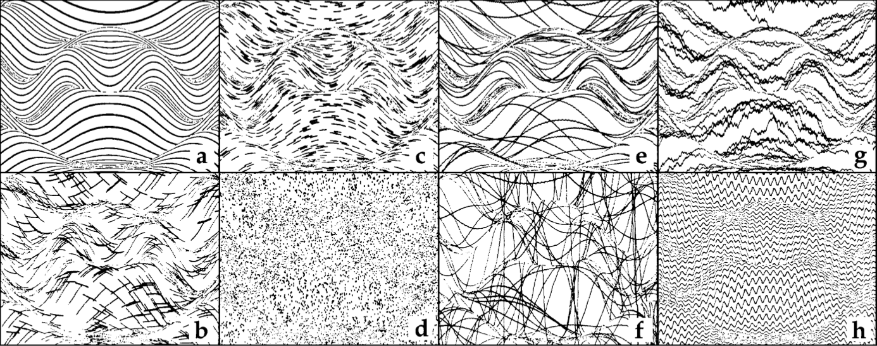
Image of Different Textures
CC: James Todd, a psychology professor; Visual Perception of Smoothly Curved Surfaces from Double-Projected Contour Patterns”, Journal of Experimental Psychology: Human Perception and Performance, 1990.
Notes:
Studies have shown that using an appropriate texture can provide improved perception of the shape of an object.

Slide 4
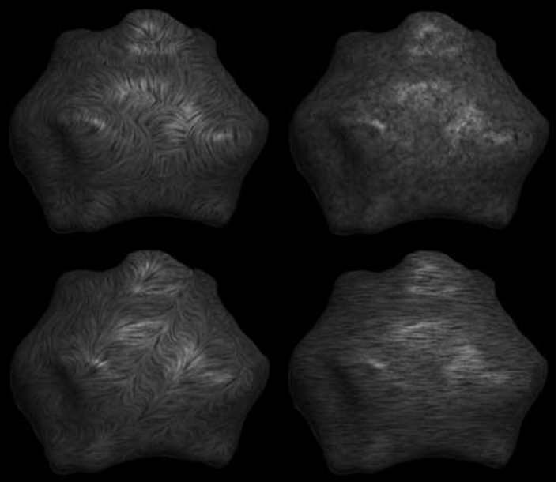
Image of Different Textures
Top-Left: 1st principal direction
Top-Right: isotrophic / random
Bottom-Left: swirly
Bottom-Right: Uniform
* 1st principal direction of a vertex on a surface is the greatest curvature at that point.

Slide 5
Purpose
Add motion to image to enhance shape reception
Two types of motion:
Motion of textured surface / object
Motion of the texture elements on stationary object (follow 1st Principal Direction)
Notes:
In our project, we consider the impact of motion on the accuracy of shape perception. Structure-from-motion provides a strong shape cue and we hope it can evaluate its effect on shape perception by comparing the accuracy obtained through motion of a textured object itself, and through the motion of texture on a stationary object.

Slide 6
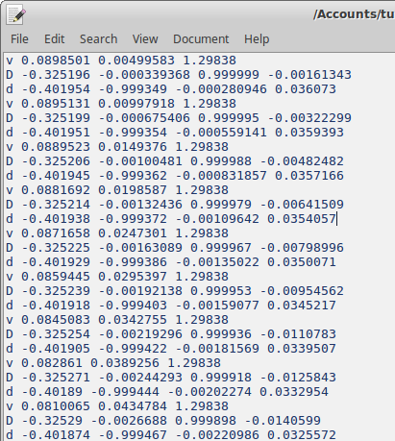
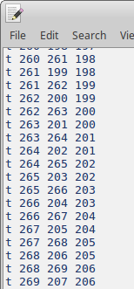
Load 3D Shape from Files
File contains:
For each vertex:
Location (x, y, z coordinates)
1st & 2nd Principal Direction
Three vertices for each triangle

Slide 7
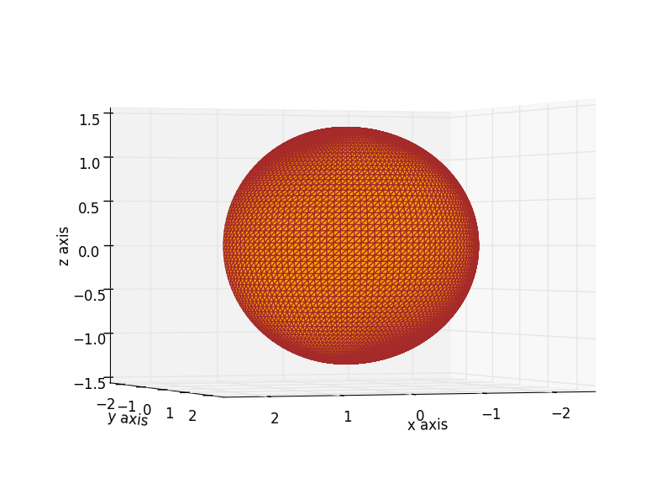
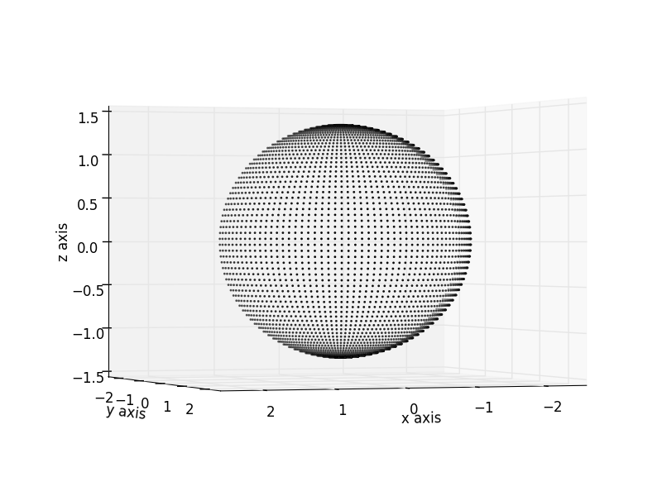
Load 3D Shape from Files
3D ellipse with only vertices
3D ellipse with triangle surface

Slide 8
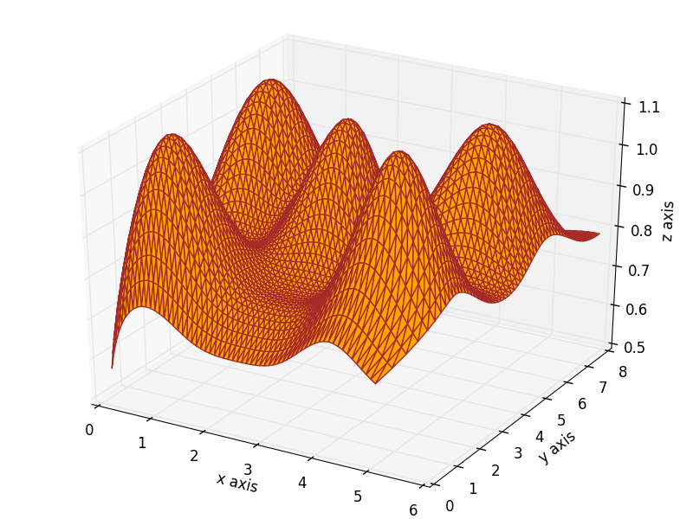
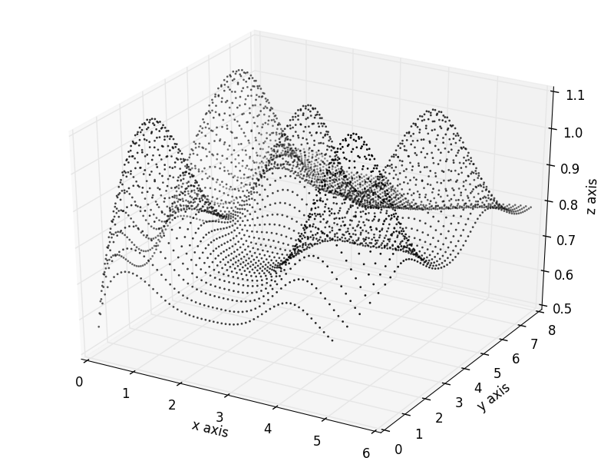
Load 3D Shape from Files
3D spline with only vertices
3D spline with triangle surface

Slide 9
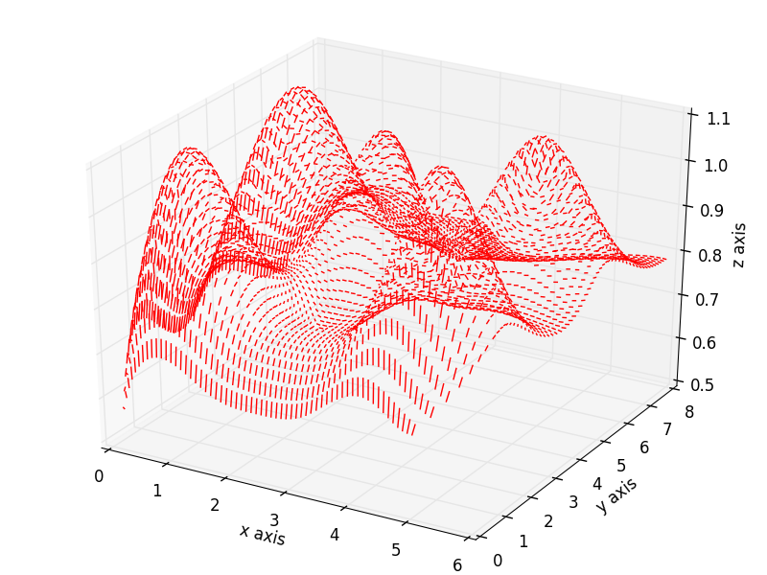
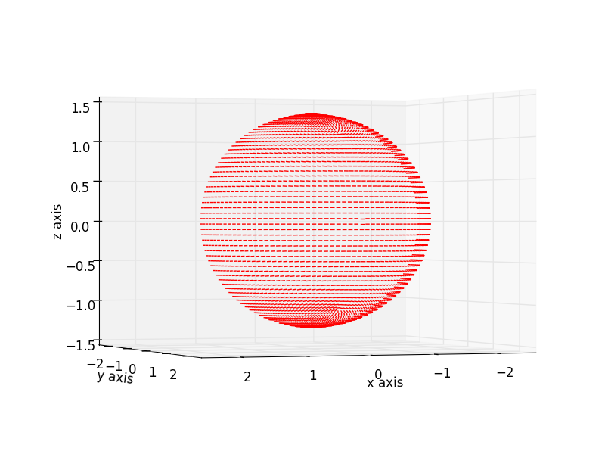
Load 3D Shape from Files
3D Ellipse with 1st Principal Direction
3D Spline with 1st Principal Direction

Slide 10
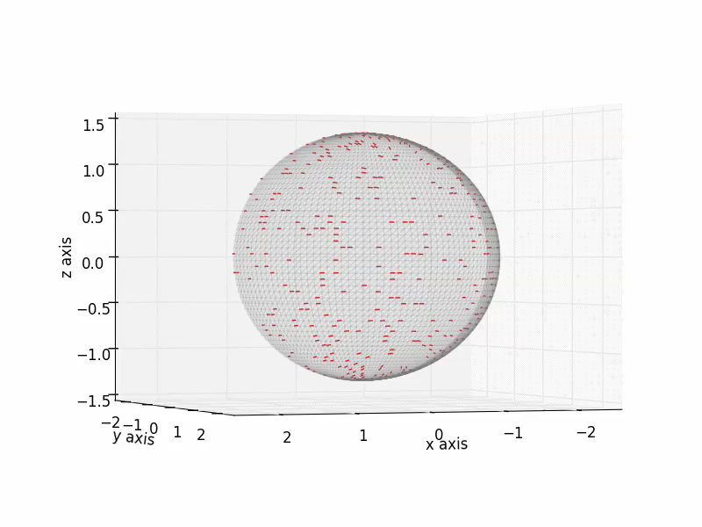
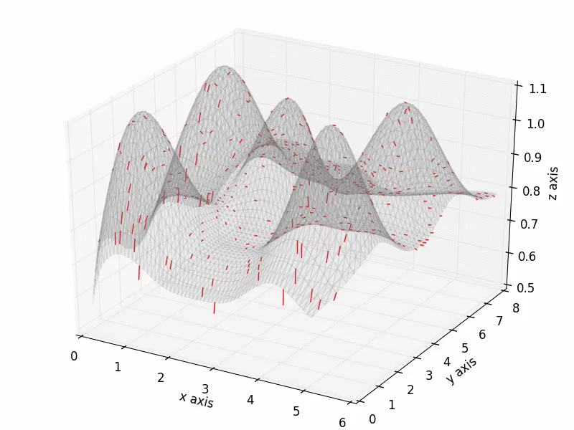
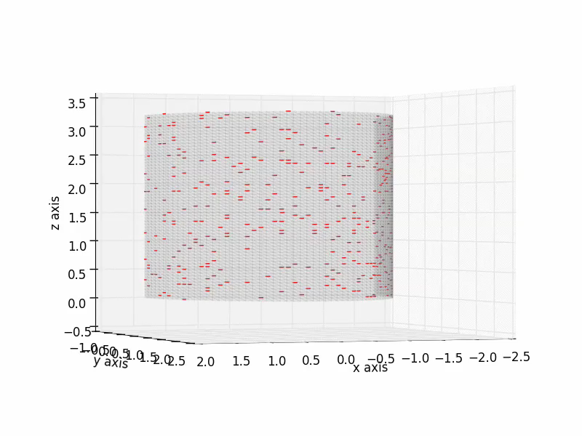
3D Shape with Motion (1st Principal Direction) Add
3D Ellipse
3D Cylinder
3D Spline

Slide 11
Next Step
Avoid duplicate moving particles / points (Apply Cluster Algorithm)
Create Proper 3D Graphics using OpenGL / Pyglet

